Slide 1



Slide 2
Contents
Overview of the App
Admin Activity:
Teacher Registration
Student Registration
Files and Query Management
Teacher Activity:
Real-Time Attendance
Edit Attendance
Uploading notes(images/PDFs)
Answering Students’ Queries in QueryBox
Student Activity:
Check Attendance
Downloading notes(images/PDFs)
Raising Queries using QueryBox

Slide 3

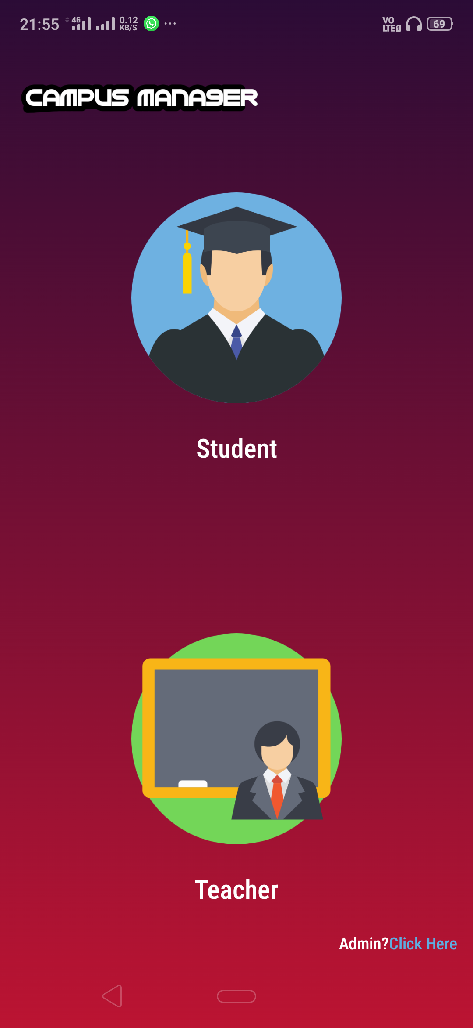
App Overview
This App provides a platform for both the Students and the Teachers to address in-campus issues which is managed by the Administrator.
The main objective of building an app like this is to bridge the gap between the teachers and students on grounds of communication.
It addresses the problems faced by both the teachers and students regarding Attendance, Solving of doubts and Sharing of notes, all under the same roof.

Slide 4
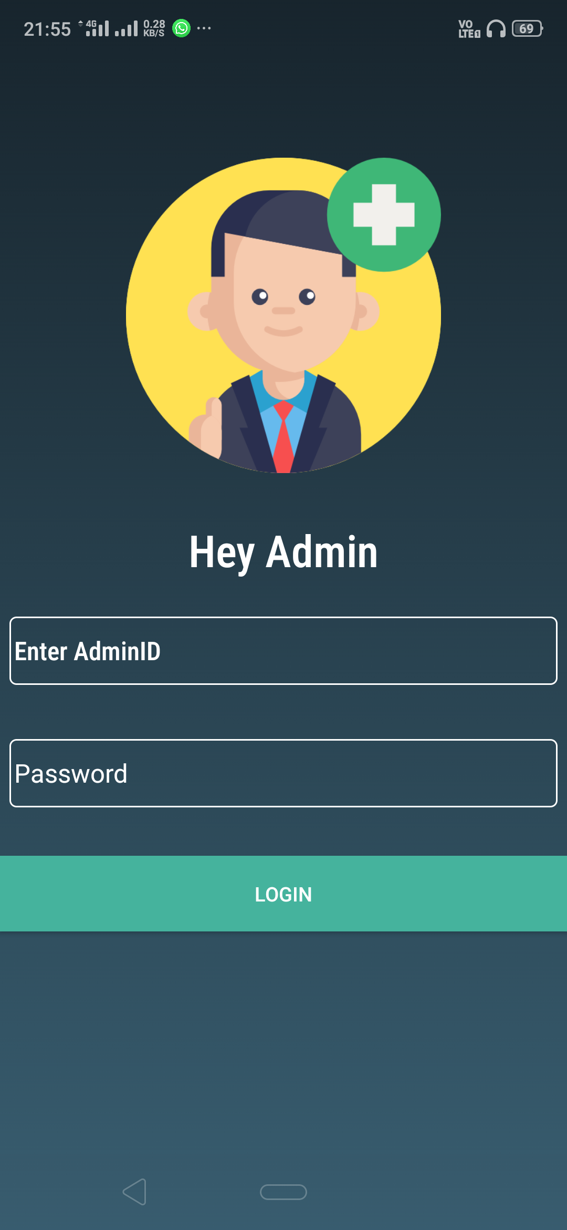
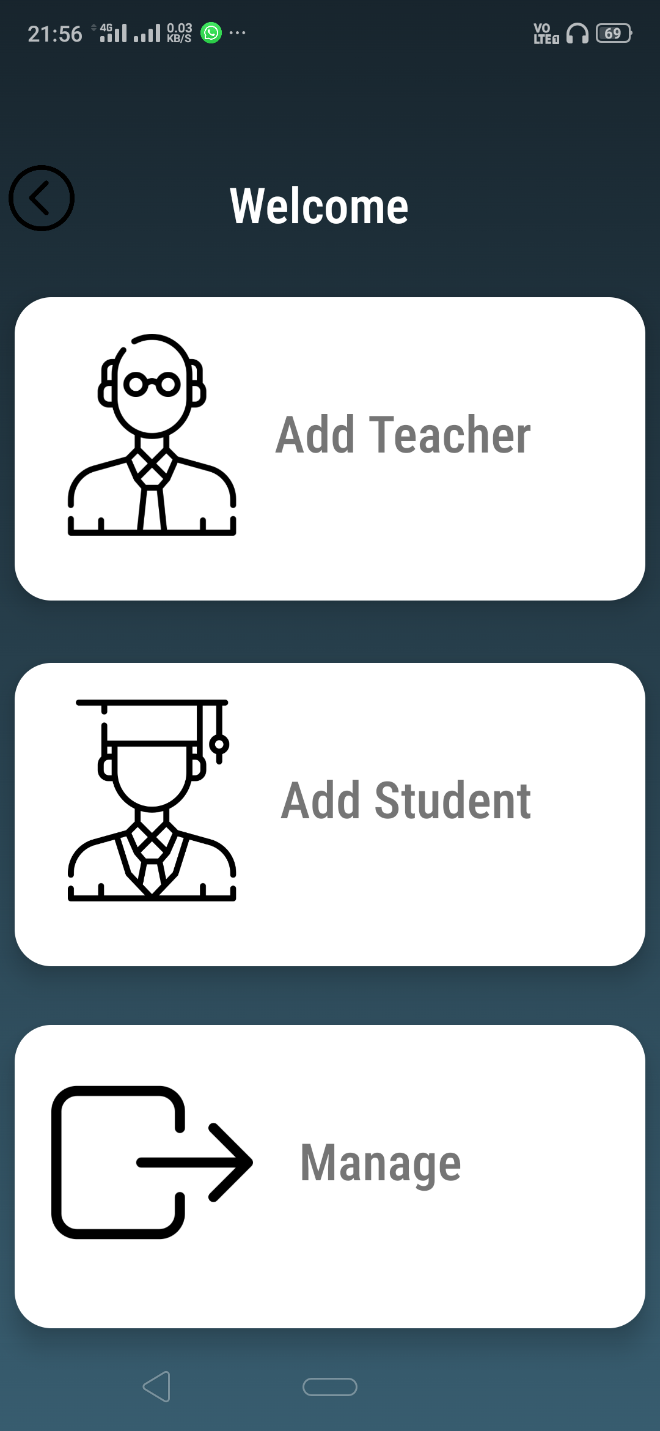
ADMIN ACTIVITY
This app is managed by a single admin. The admin is responsible for adding teachers and students and managing actions over the online database. These actions may be related to subject designation, file sharing and teacher-student queries. This app has a preset admin id and password.

Slide 5
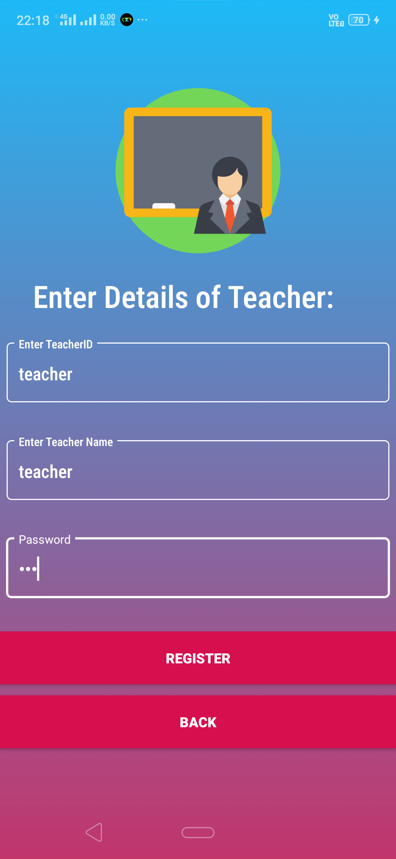
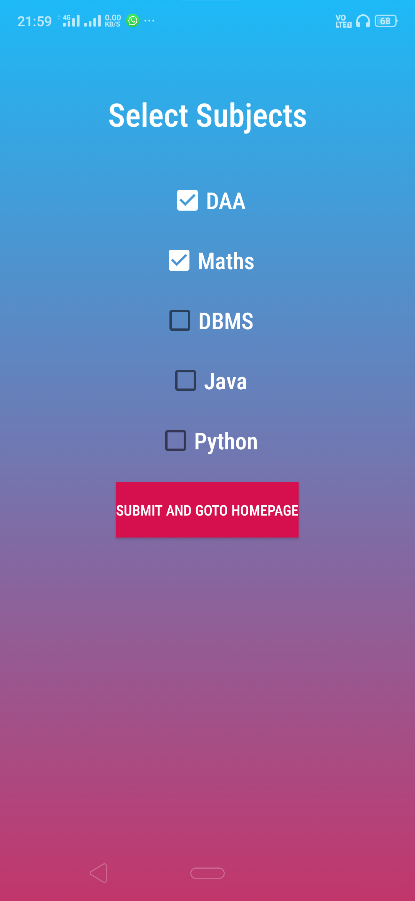
Teacher Registration
These pages provide an interface to the admin to register eligible teachers and designate their respective subjects.
A teacher cannot access the contents inside a subject which the admin has not registered him/her in.

Slide 6
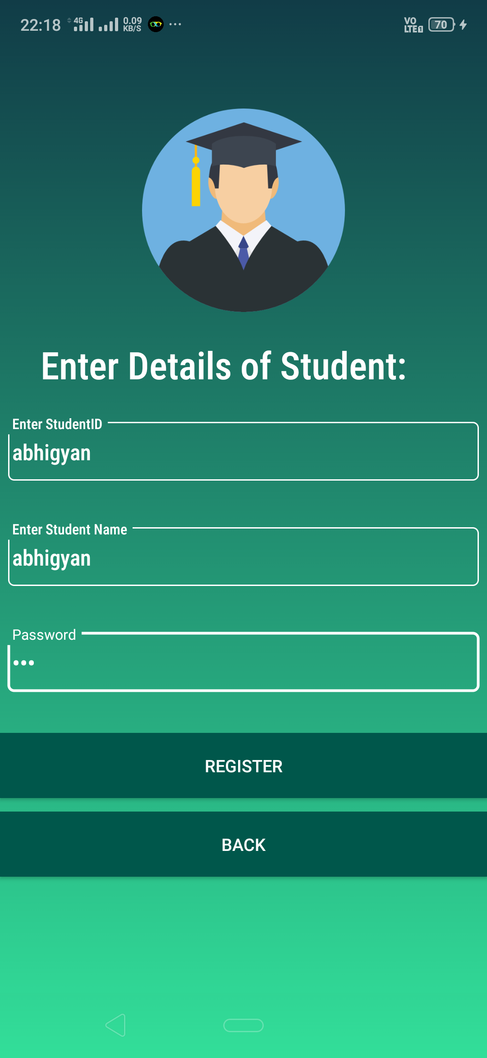
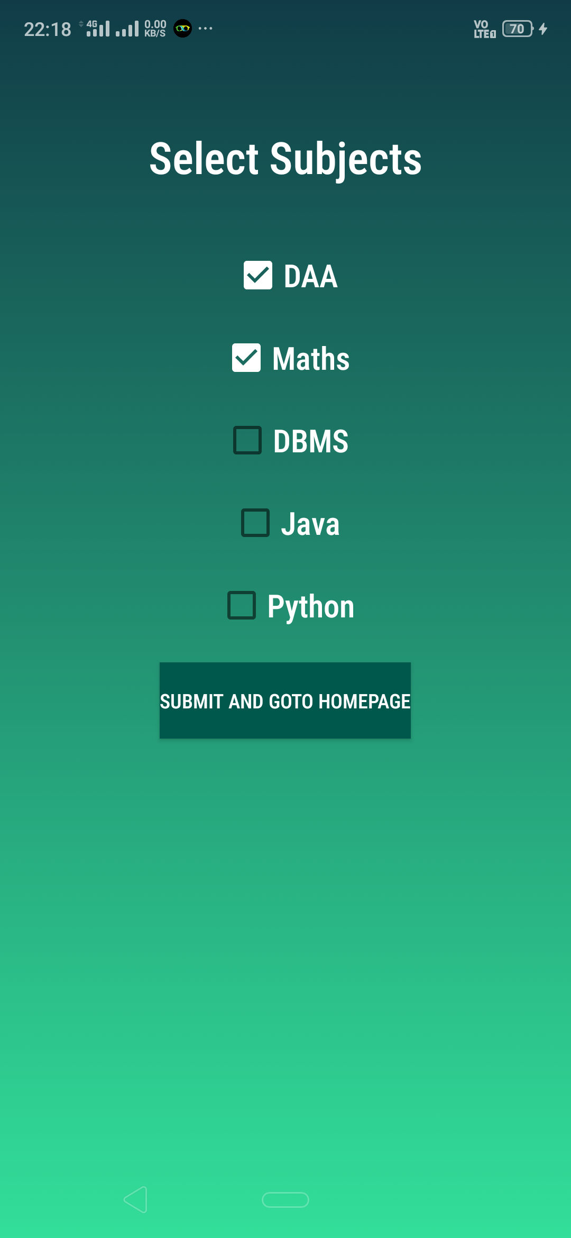
STUDENT REGISTRATION
These pages provide an interface to the admin to enroll eligible students into their respective subjects.
A student can view his/her attendance only for the enrolled subjects.

Slide 7
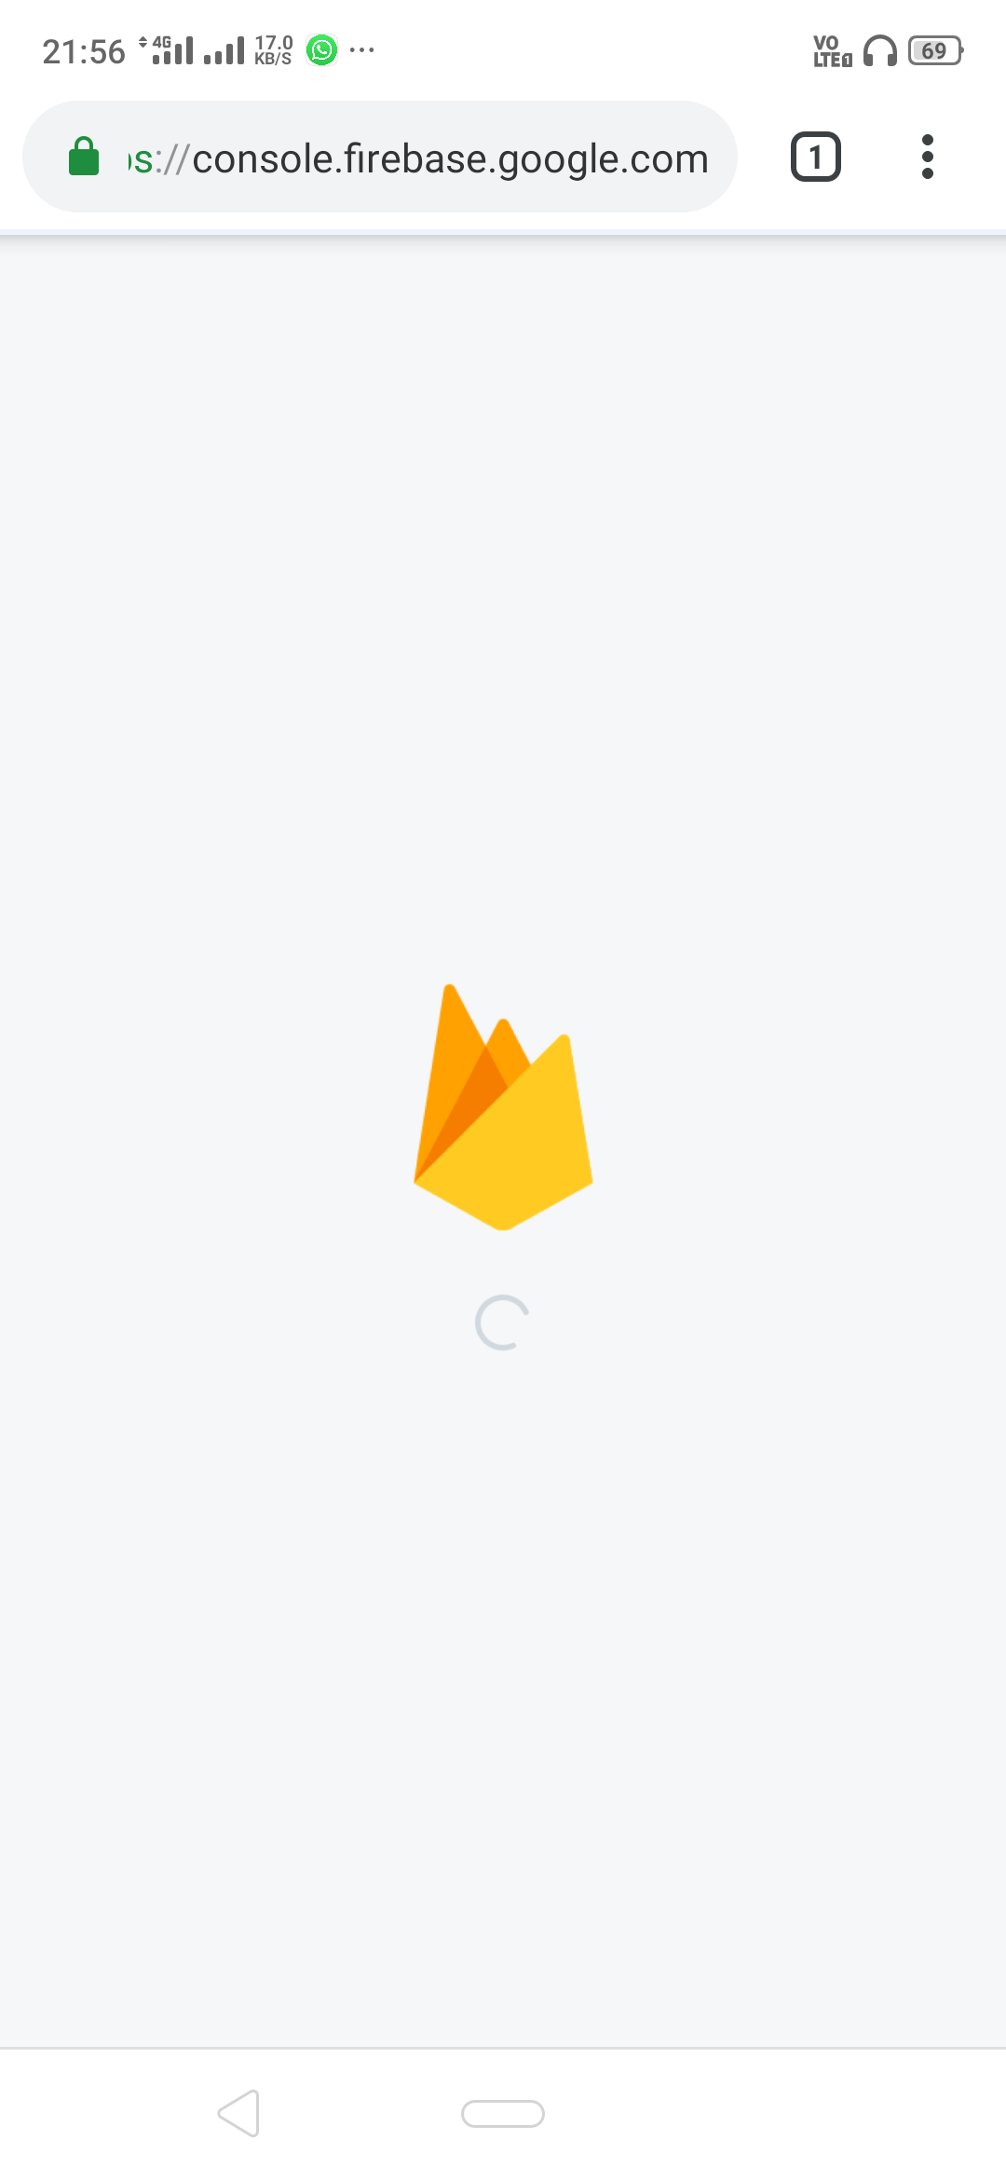
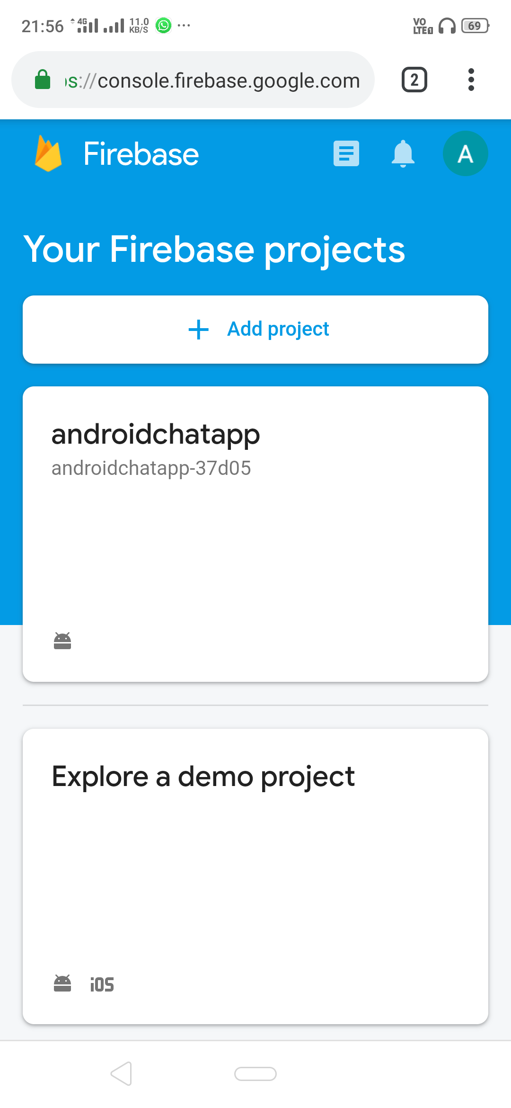
Manage Firebase
This web-view activity provides an interface to the admin to manage all the messages and files shared over the Google Firebase Real-Time database and Storage.

Slide 8
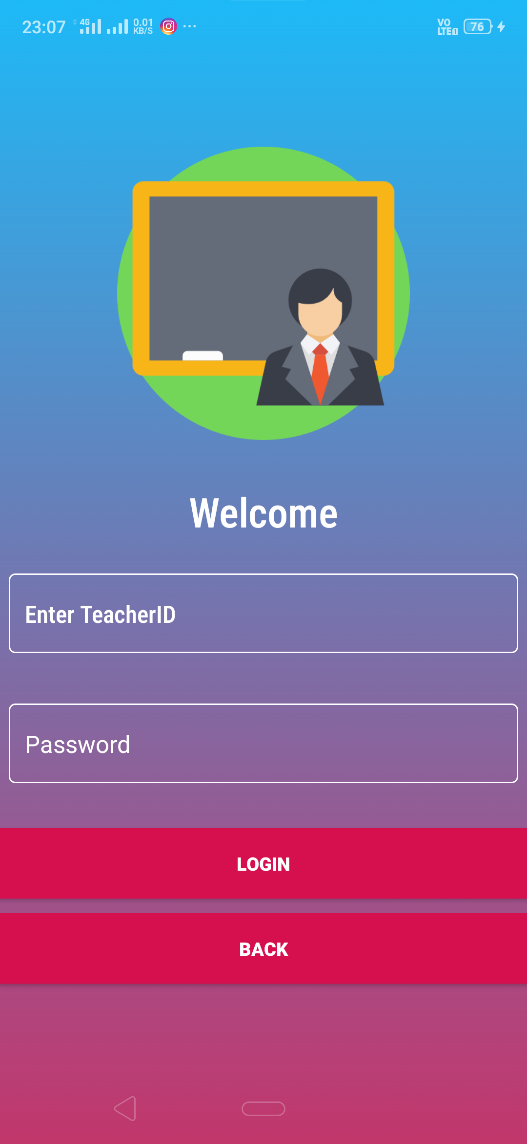
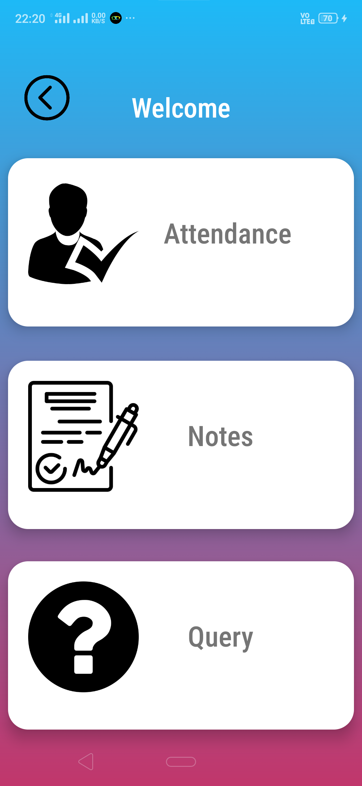
Teacher Activity
Once a teacher successfully logs in with the correct TeacherID and password, this page serves as an interface which guides the teacher to the various options of:
Taking Real-Time attendance
Uploading essential PDFs and Images
Answering queries of Students

Slide 9
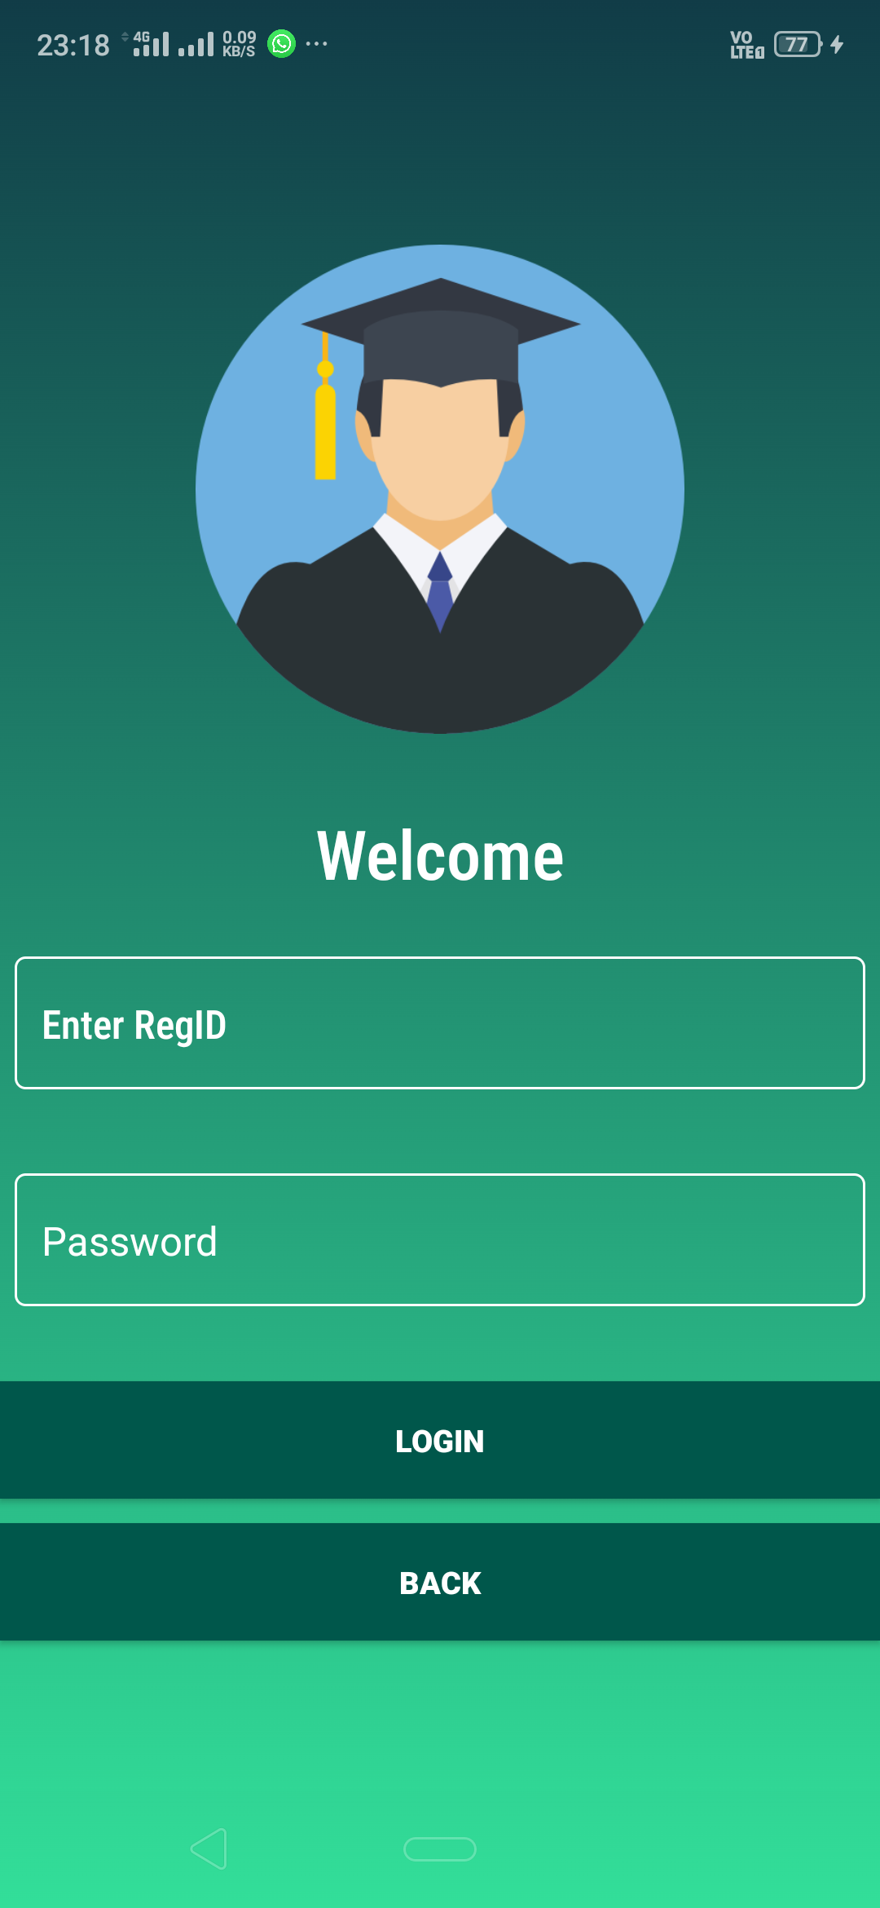
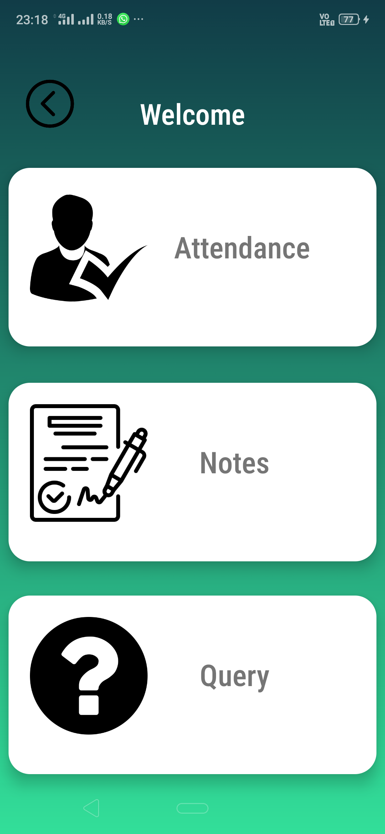
Student Activity
Once a student successfully logs in with the correct StudentID and password, this page serves as an interface which guides the Student to the various options of:
Checking attendance
Downloading the provided PDFs and Images
Raising Queries to the Teachers

Slide 10
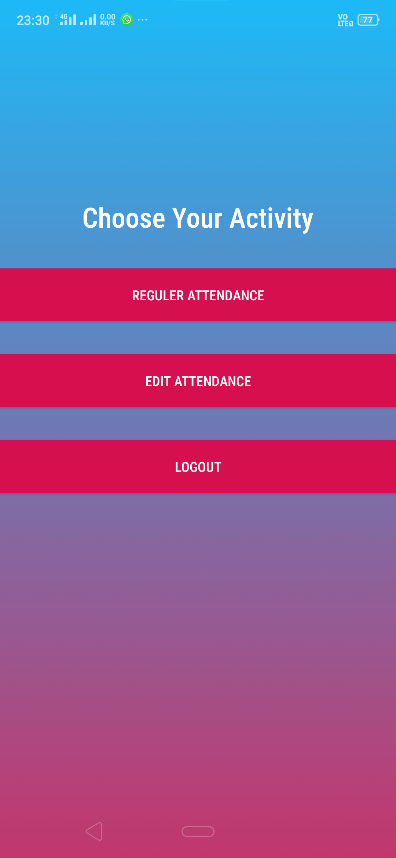
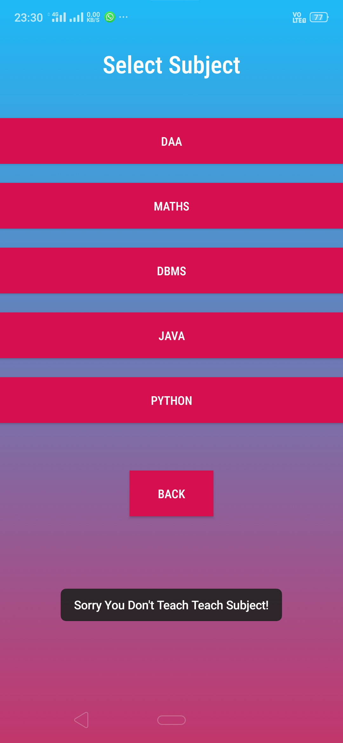
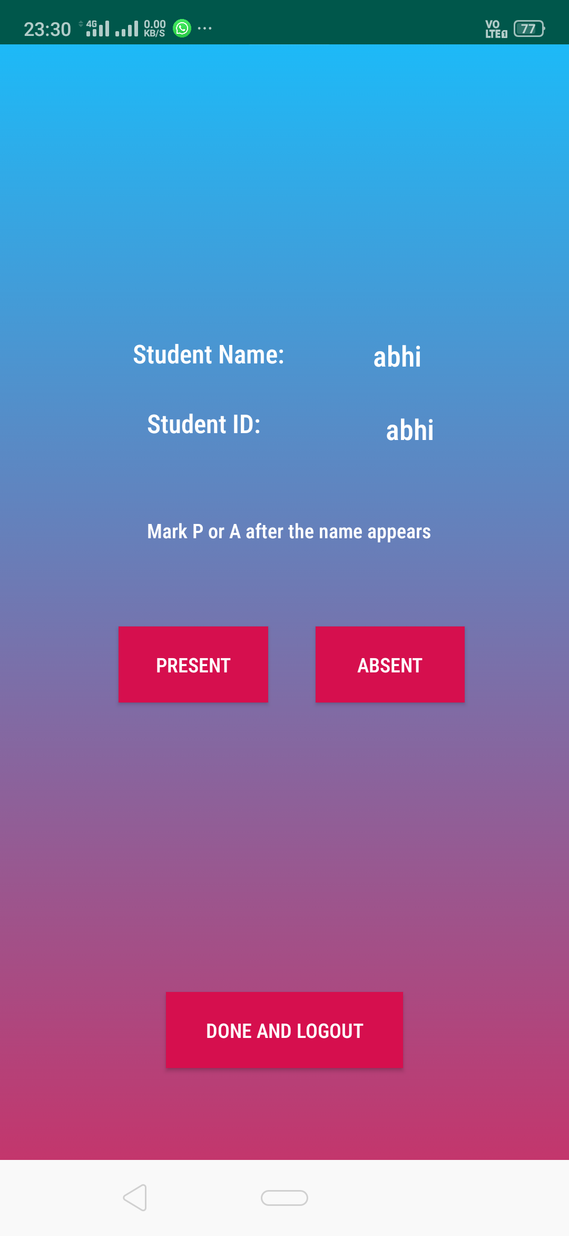
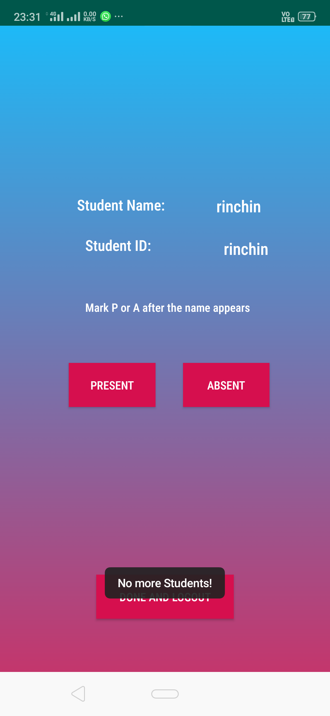
Teacher’s Attendance Activity
Teacher’s options menu
Subject selection menu
Attendance of student 1(Abhi)
Attendance of student 2(Rinchin)

Slide 11
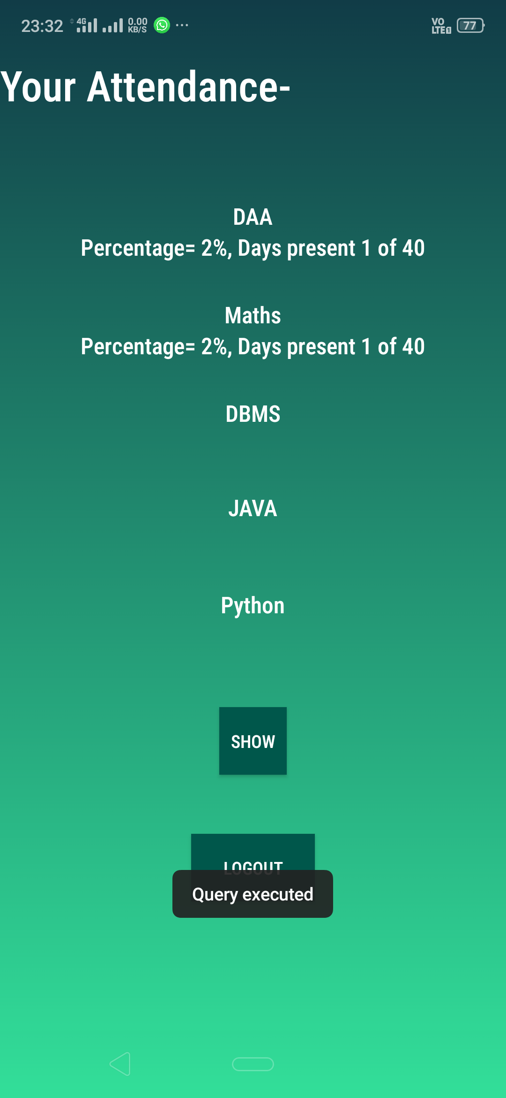

Student Attendance
The attendance of both Abhi and Rinchin can be seen here respectively. Both the students can access their own attendance by just logging into their accounts.
Abhi’s attendance
Rinchin’s attendance

Slide 12
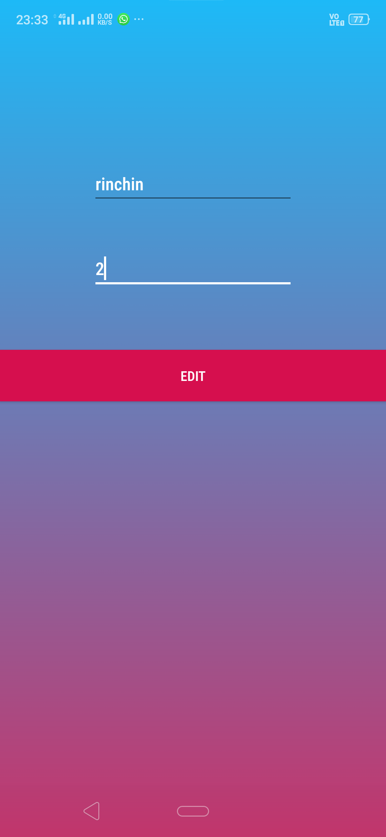
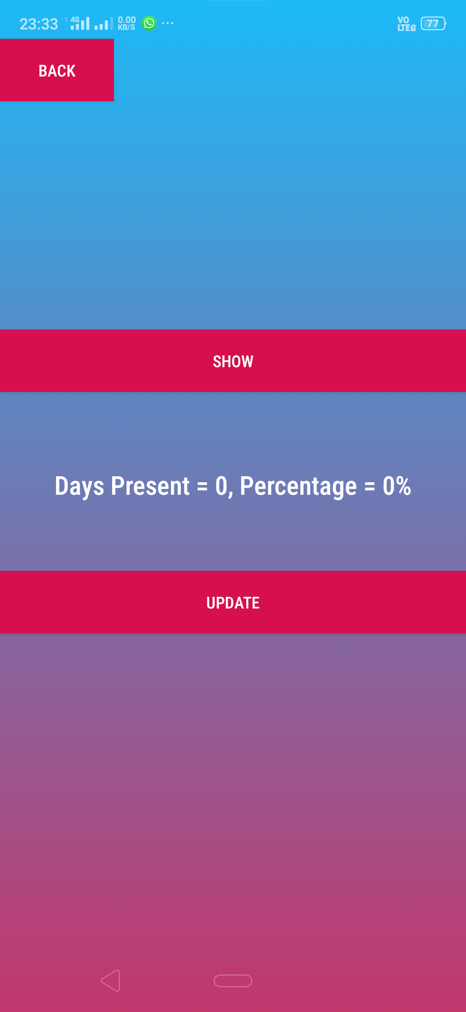
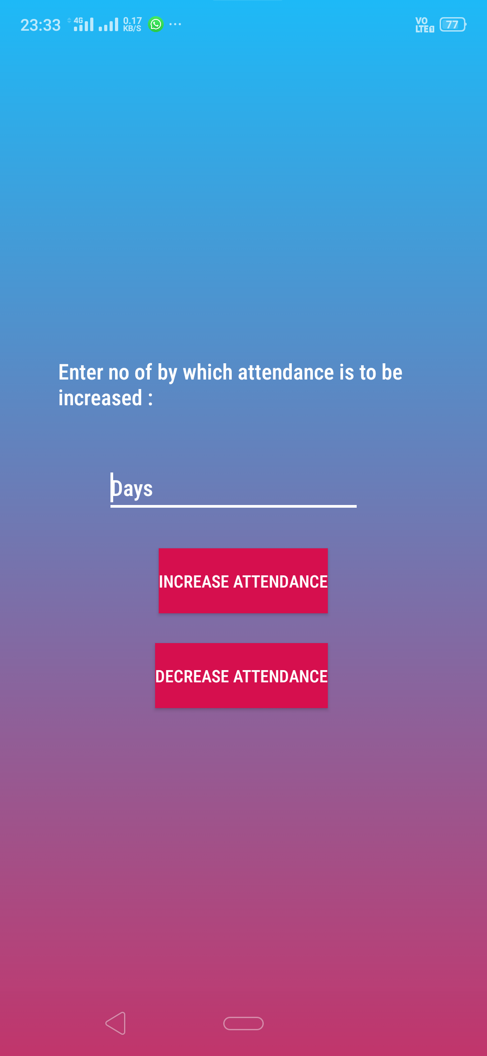
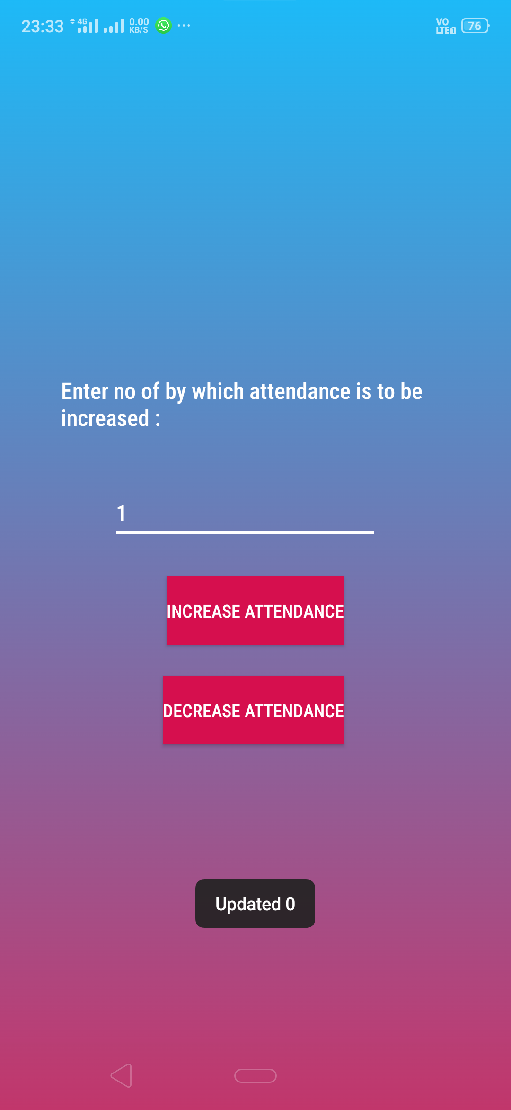
Update Attendance Activity
Teacher’s update page
Teacher side attendance view page
Update menu
Attendance updated for 1 day

Slide 13


Updated Attendance
The updated attendance can be viewed by both the teacher and the student as we can clearly see here.
Teacher side attendance view page
Student side attendance view page

Slide 14

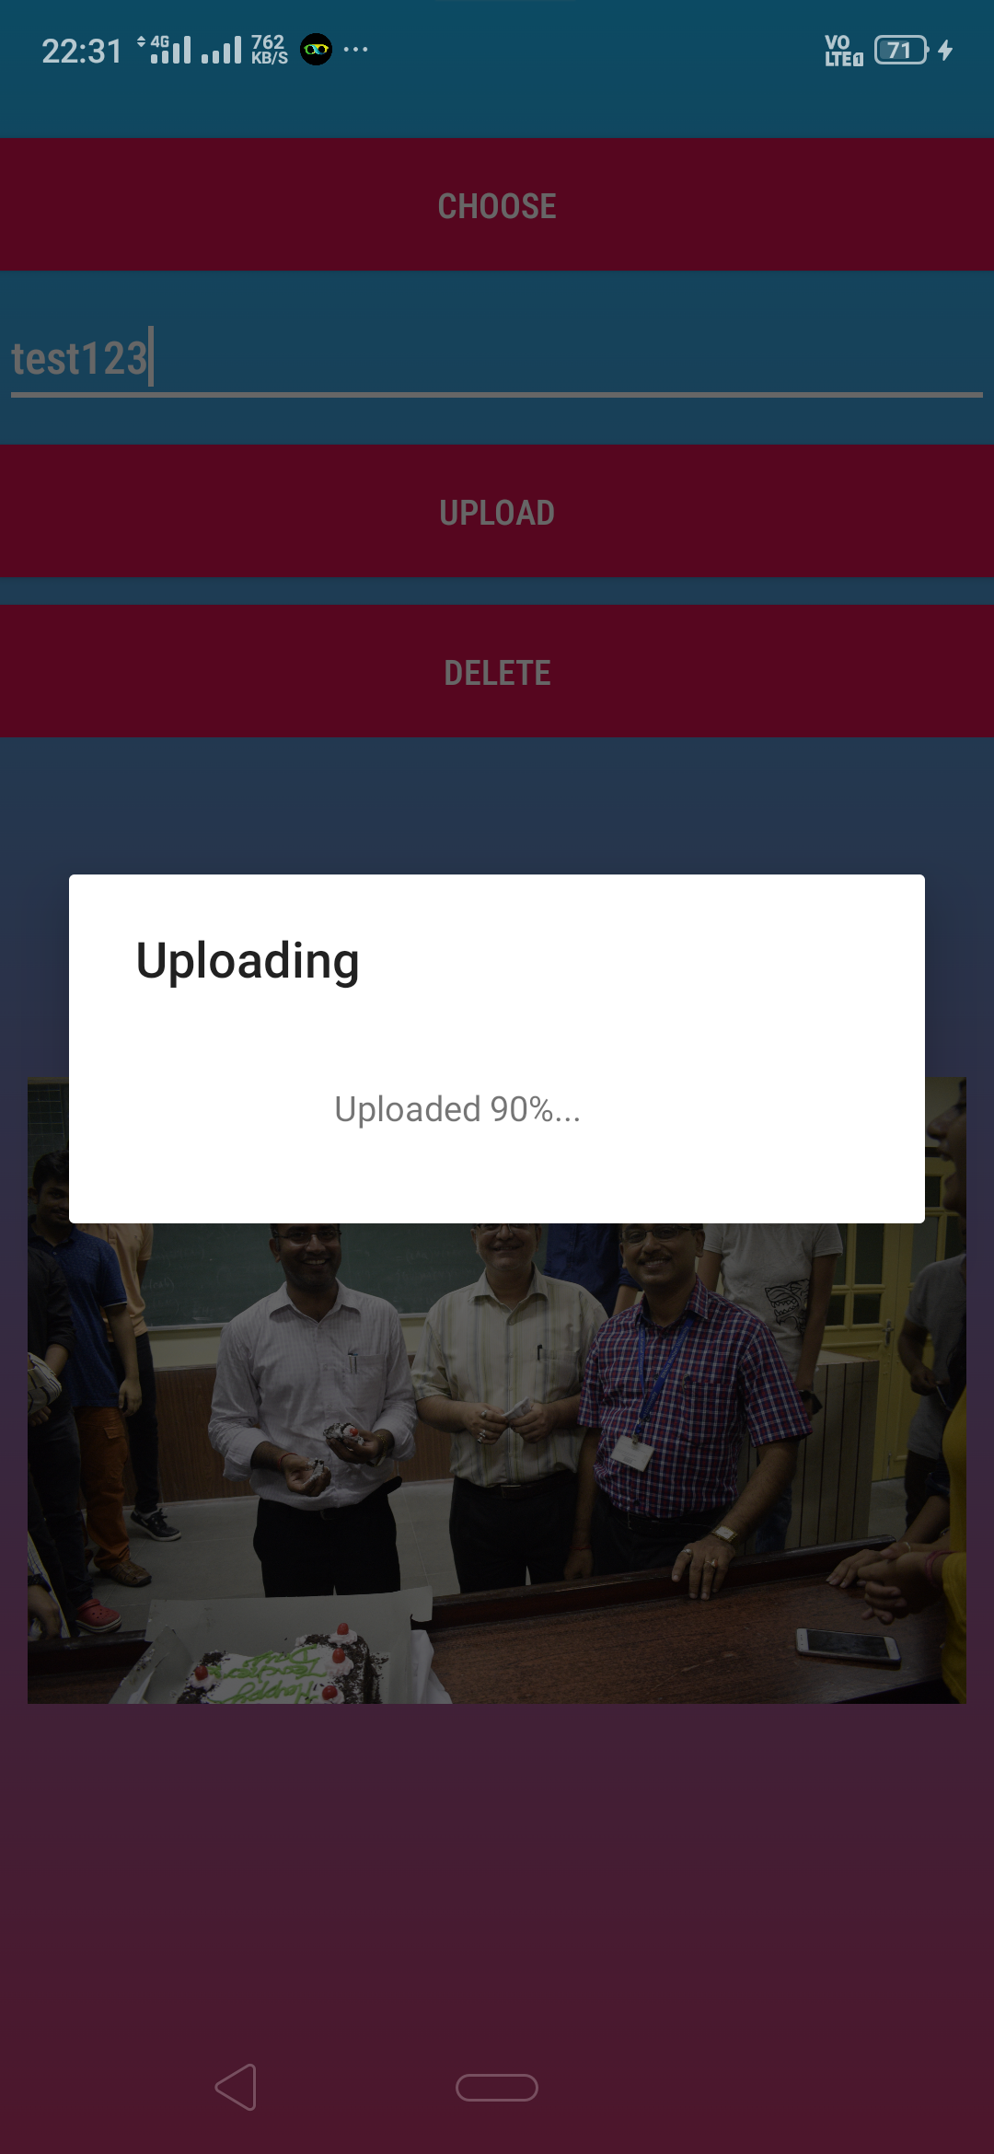
Files Upload Activity
The teacher has the option to upload notes in the form of images and pdfs

Slide 15

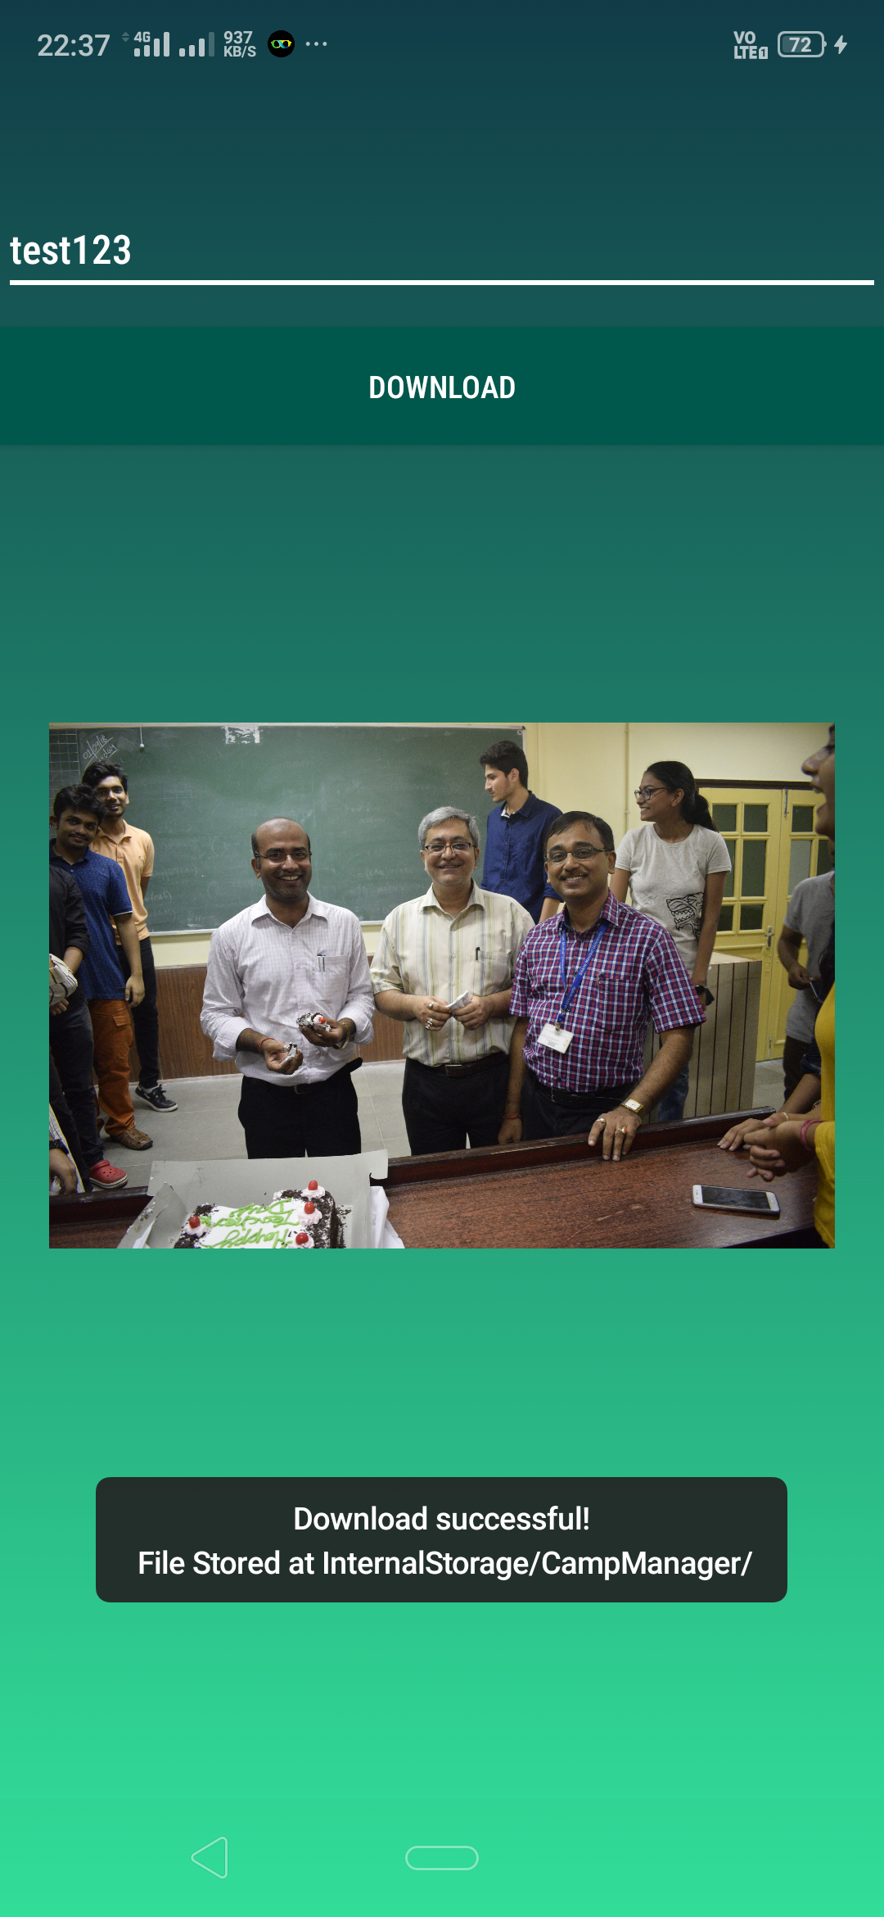
Files Download Activity
The student can download the notes which are uploaded by the Teacher.
The files get stored directly to our Local Storage so that it can be accessed offline for future use even.

Slide 16
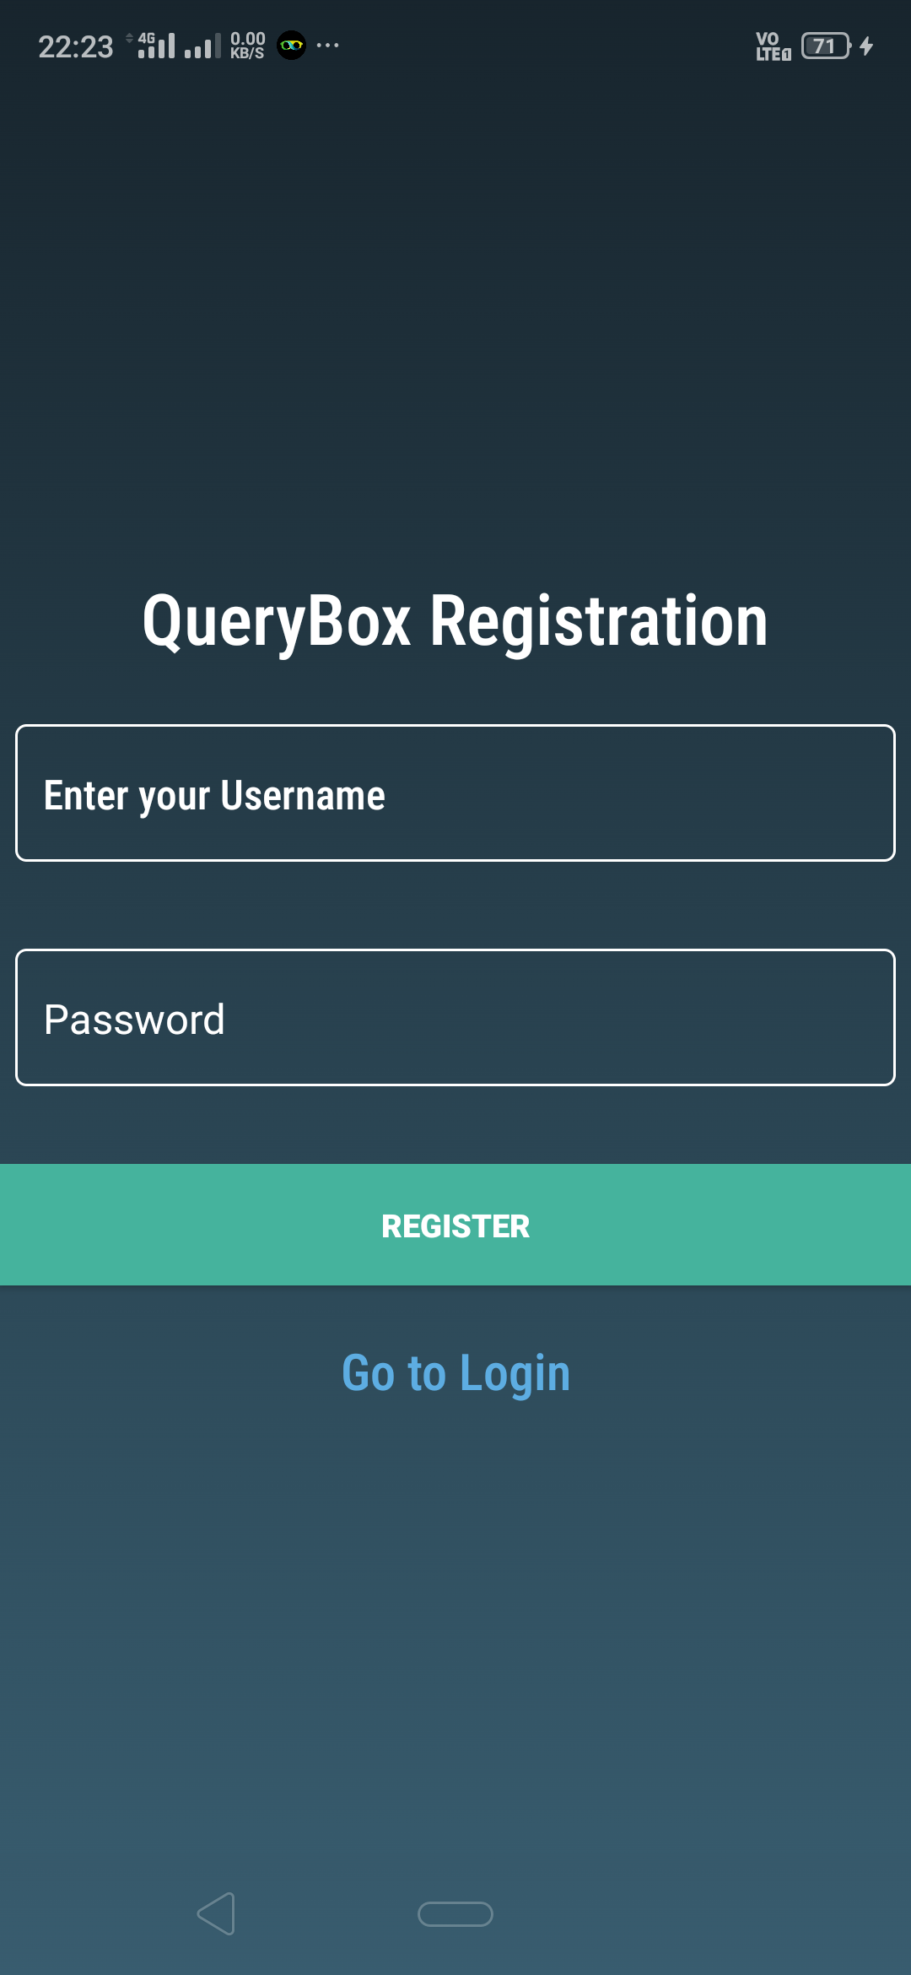
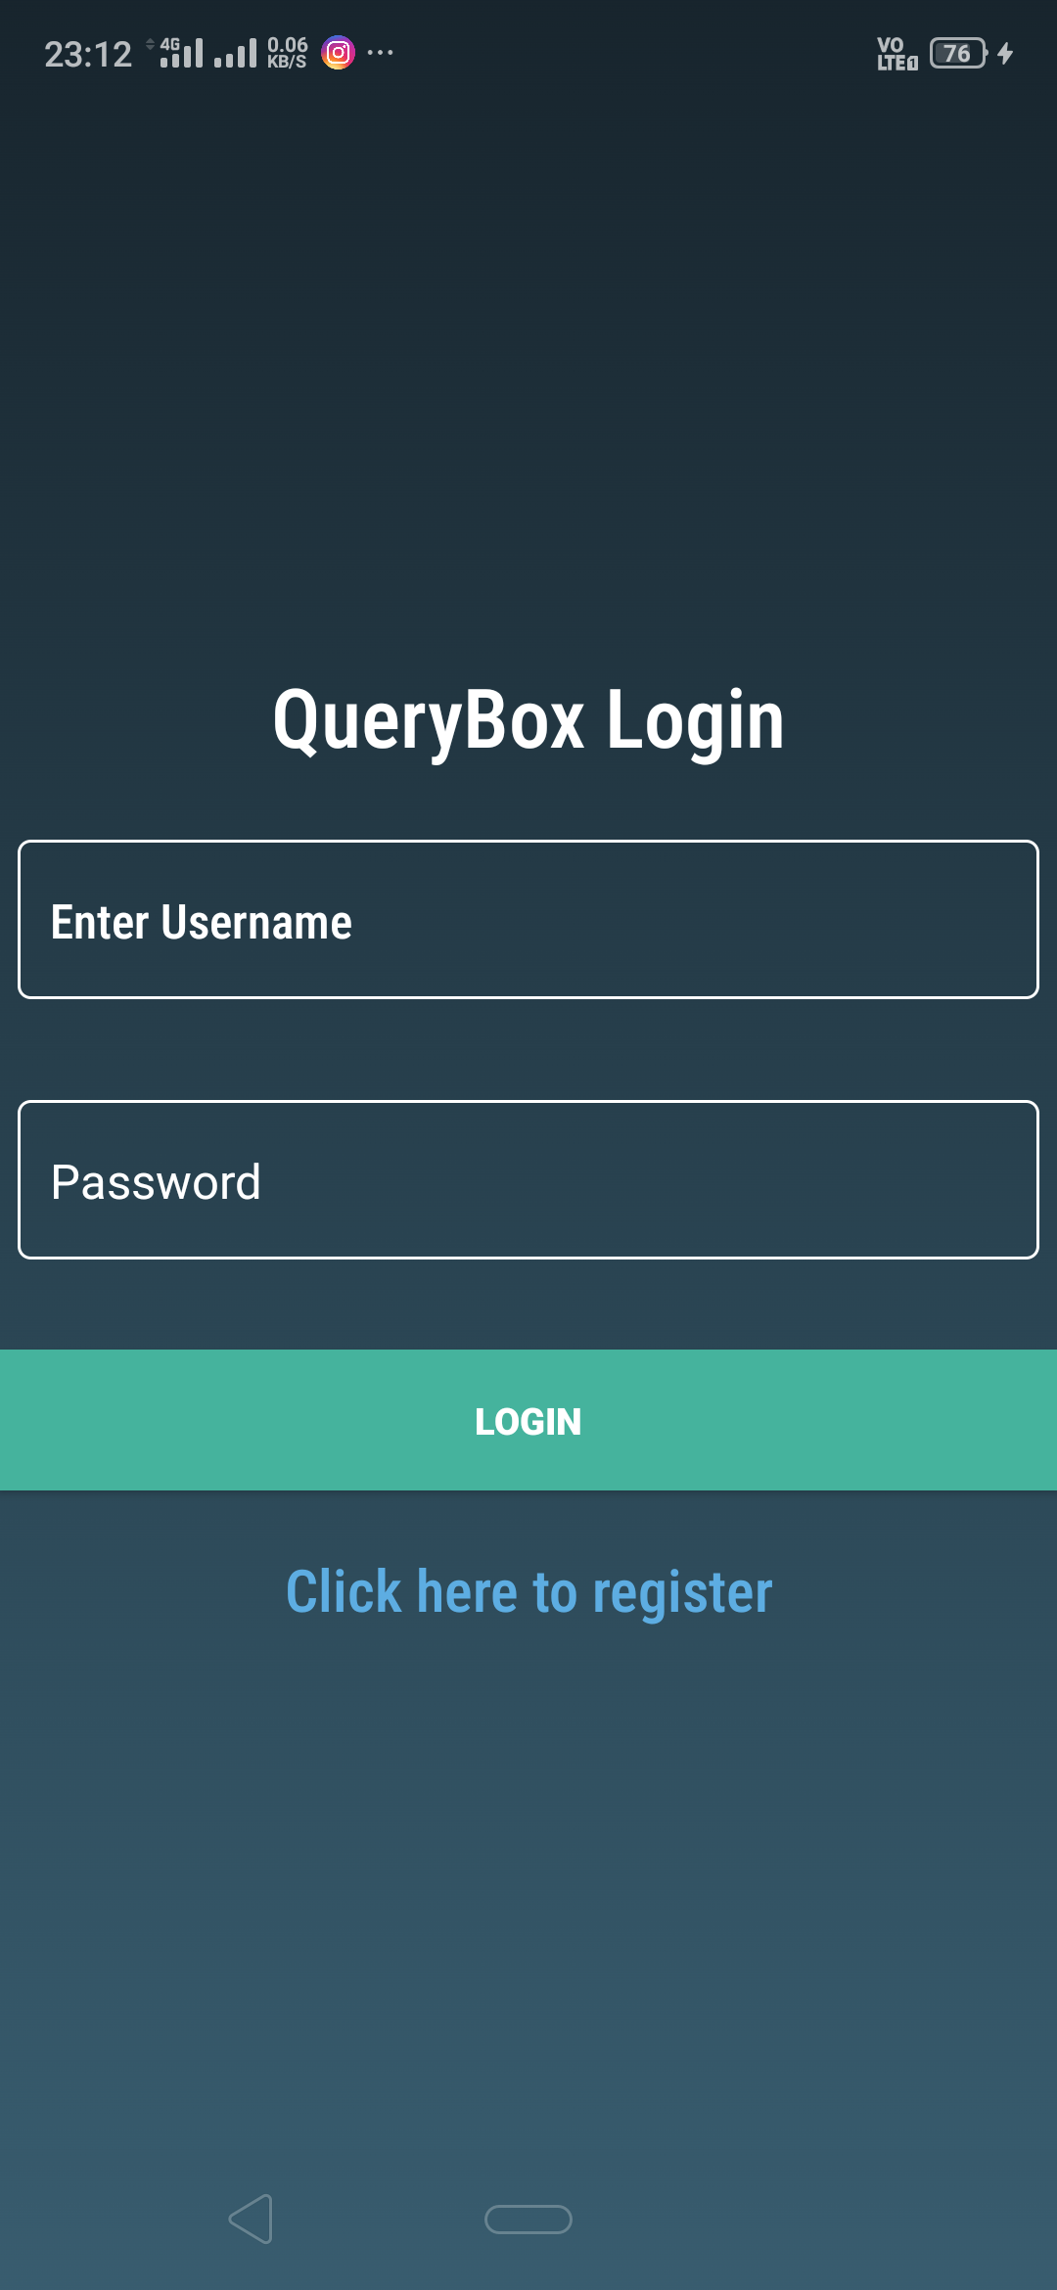
QueryBox Login And Registration
This app provides its own chatbox which is entirely based on google firebase.
Once registered, the student/teacher can communicate with each other without the need of any extra information other than the username

Slide 17
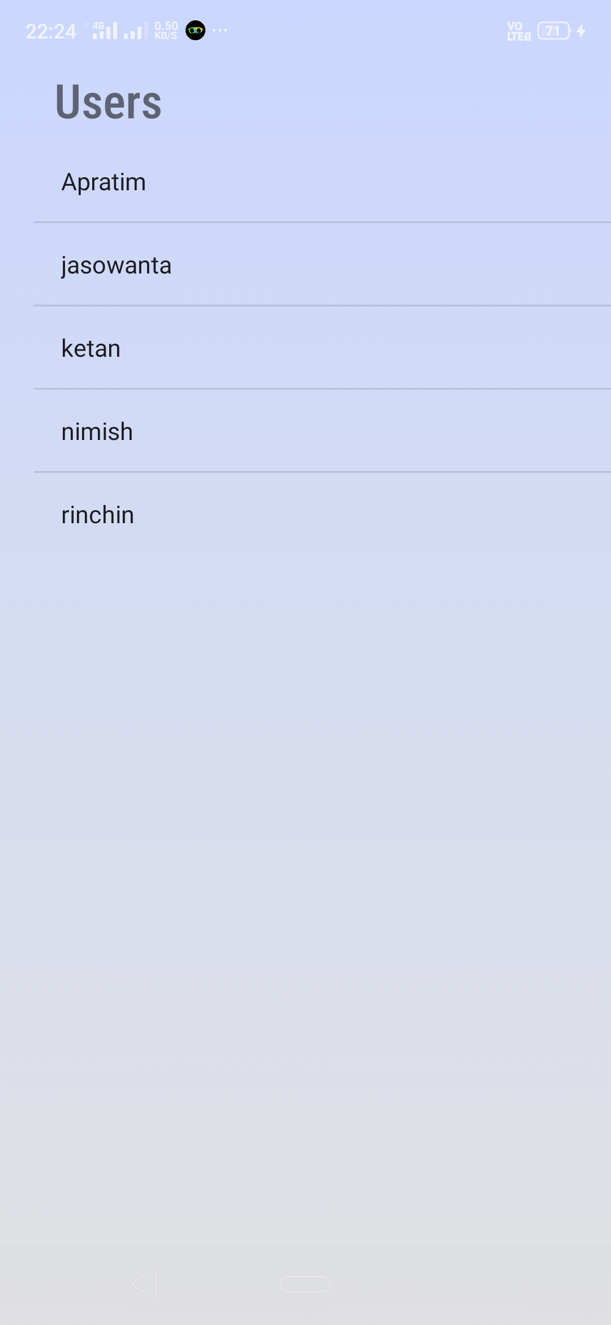
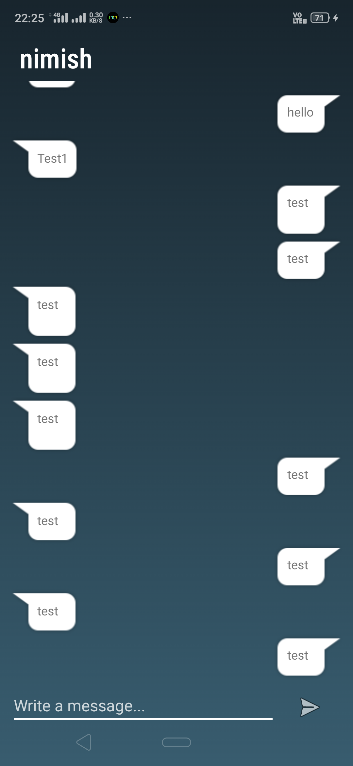
QueryBox Activity
The Users page shows the usernames of all the teachers/students who have registered in the Querybox
The chatbox provided has a simple design layout which is similar to most of the commonly used online messaging application.

Slide 18
Questions?

Slide 19




Thank you
Developed by TeamBlue
Rinchin Dorjee
Abhigyan Baruah
Nimish Bhardwaj
Jasowanta Das

